Slide 1

IBM SkillsBuild for Adult Learners - Data Analytics
Data Analytics Internship Program 2024
Final Project Presentation
Project Name: Analysis on Global Terrorism Attacks
Unique ID: IBM0266
Team Name: CODEHACK
College Name: Arya College of Engineering, JAIPUR

Slide 2









Team Members
Hardik Agrawal
Milan Harsh
Mohit Meena
Mohit Dad
Moulik Gandhi
Harsh Zindal
Bhanu Pratap
Mridu

Slide 3


Introduction
Overview of the Project
A project is focused on terrorism data analysis aims to understand patterns and trends in terrorist activities, develop predictive models for prevention, inform effective counter-terrorism policies, and identify the root causes of terrorism.
The project contributes to global efforts in reducing terrorism and promoting peace and security.
Objective
Optimize Data Collection
Enhance Analytical Techniques
Strengthen Collaboration Networks

Slide 4
Problem Identification
Problem Statement
This project aims to use data analysis to find trends, predict possible attacks and improve policies. It will also look at the social and economic impacts of terrorism to help create better ways to prevent and respond to it.
Significance of The Problem
We will use data analysis to tackle terrorism. The project is essential for:
Boosting security.
Creating better policies.
Reducing economic and social harm.
Making the best use of resources.
Encouraging global teamwork and helping affected people.
Relevant SDGs
SDG 16 : Promote peaceful and inclusive societies for sustainable development, provide access to justice for all and build effective, accountable and inclusive institutions at all levels.

Slide 5



Data collection
Source of Data
The project will use terrorism datasets from the following sources:
Kaggle: Various terrorism datasets are available on Kaggle, such as the "Global Terrorism Dataset".
RAND: RAND is a research organization that develops solutions to public policy challenges to help make communities throughout the world safer and more secure, healthier and more prosperous.
START: A consortium of researchers dedicated to improving the understanding of the human causes and consequences of terrorism.

Slide 6
Data collection
Data Description
The global terrorism dataset contains information on terrorist incidents. This dataset provides insights into the dynamics of terrorism attacks worldwide.
The date and time of the attack
Weapon used in the attack
Duration of the attack
Region attacked
Target name
Attack type
Perpetrator group name
Fatalities involved, etc.
Data Collection Methods
The database is maintained by researchers at the National Consortium for the Study of Terrorism and Responses to Terrorism (START), headquartered at the University of Maryland. The dataset is collected for the attacks between 1970-2017. In order to maximize the efficiency, accuracy and completeness of GTD collection, the GTD team at
START combines automated and manual data collection strategies.

Slide 7
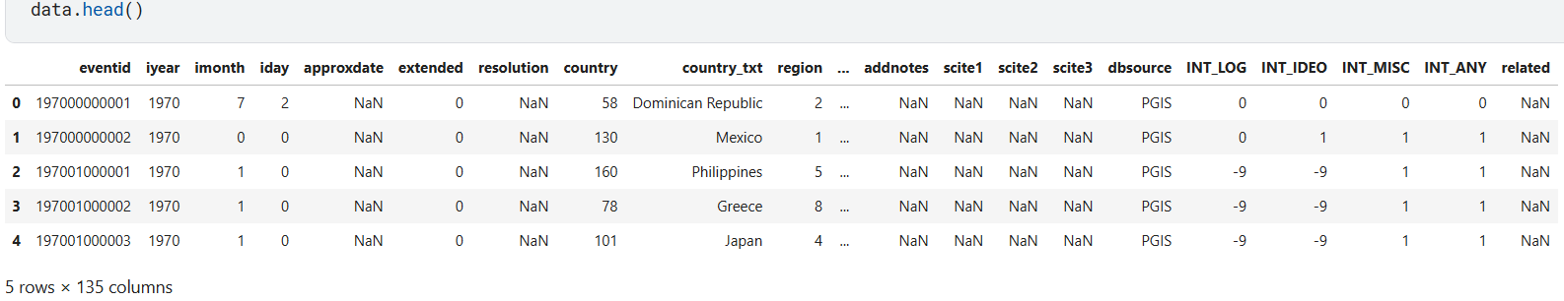
Data Preprocessing
Data Before Cleaning
Initially, our data has 135 columns in which most of them doesn’t have relevant information. So, we will keep only those columns that are relevant.

Slide 8
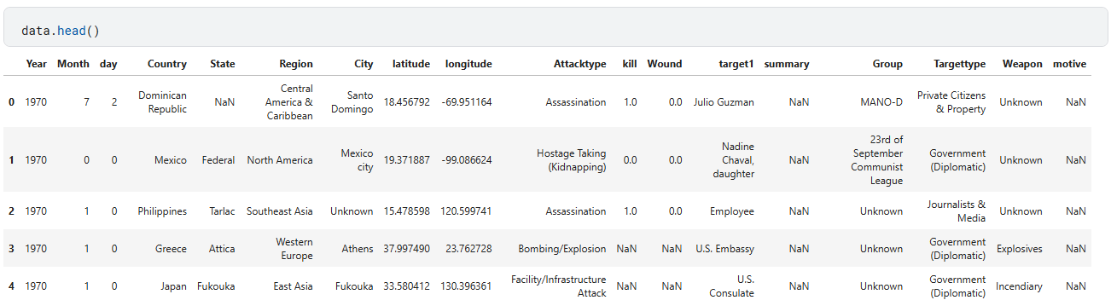
Data Preprocessing
Data After Cleaning
Now, the dataset has 18 columns. Since, the data has NaN or null values so, we have to handle those values too.

Slide 9

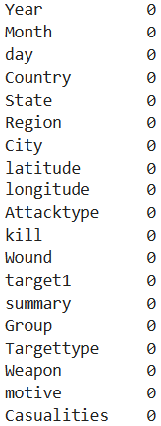
Data Preprocessing
Handling Missing Values
We have replaced all null values with either “0” or 0. So, the missing values are now handled. The data transformed in the form so that we can use the data for further data analytics.

Slide 10
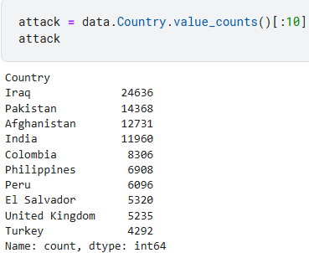
Data Analysis
Analytical Tools Used
Analytical Tools
The following tools and technologies will be used for data analysis:
Python: For data cleaning, analysis, and visualization, using libraries such as Pandas, NumPy, Matplotlib, and Seaborn.
Jupyter Notebooks: For documenting the analysis process and visualizations.
We got to know about the top 10 most attacked countries in which Iraq and Pakistan are the hotspots.

Slide 11
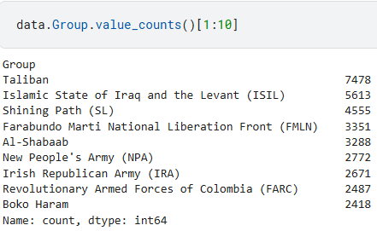
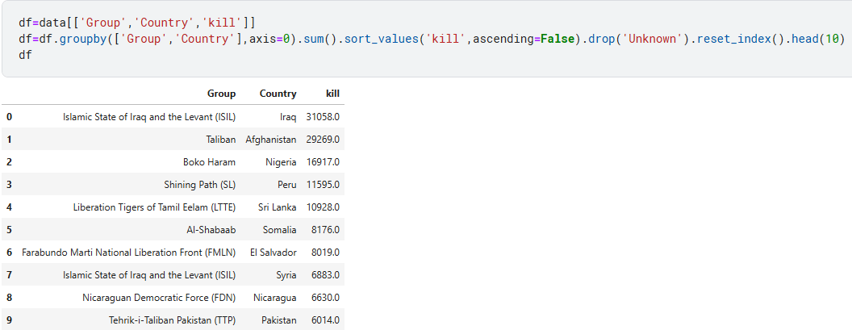
Key Findings
We have compiled a list of the top 10 most active terrorist groups, with the Taliban having the highest number of attacks.
By grouping the data by country, group, and number of kills, we obtain a list sorted by the highest number of kills.

Slide 12
Insights Derived
There seems to be a peak in terrorist activities in certain years.
Specific regions and countries are more vulnerable to terrorism.
Certain types of attacks and targets are more prevalent.
Some terrorist groups are significantly more active and deadly than others.
There is a strong correlation between certain terrorist groups and the countries they operate in.

Slide 13

Hypothesis Development
Formulated Hypothesis
Incidents are concentrated in politically unstable regions.
Peaks in incidents occur during specific periods.
Attack types may correlate with targets.
Different groups might prefer certain weapons.
Casualty numbers could depend on attack type and preparedness
.Motivations vary by region and time.
Data source reliability affects information accuracy.
Rationalise Behind the Hypothesis
Strategic objective target vulnerability symbolism Resource Availability Historical Precedents Operational Tactics.

Slide 14
Solution Design
Address Root Causes
Economic Development: Reduce poverty, create jobs.
Education: Promote tolerance, prevent radicalization.
Social Inclusion: Ensure equal opportunities, address injustices.
Strengthen Legal & Institutional Frameworks
Governance: Enhance transparency, reduce corruption.
International Cooperation: Share information, collaborate globally.
Legislation: Enforce anti-terrorism laws respecting human rights.
Enhance Security & Law Enforcement
Capacity Building: Train and equip law enforcement.
Border Security: Prevent terrorist movements.
Rapid Response: Develop swift response units.
Community Engagement & De-Radicalization
Programs: Build community resilience.
Rehabilitation: De-radicalize former extremists.
Dialogue: Foster interfaith and intercultural understanding.
Counter-Terrorism Financing
Disrupt Networks: Dismantle funding channels.
Regulations: Strengthen financial oversight.
Sanctions: Enforce international penalties.

Slide 15

Implementation Plan
1. Data Collection
Identify and obtain reliable sources of global terrorism data.
Download datasets containing details on terrorist incidents, including attack types, targets, locations, dates, groups, and casualties.
2. Data Preprocessing
Clean the data by removing duplicates, handling missing values, and standardizing formats.
Categorize the data into predefined categories for attack types and target types.
3. Exploratory Data Analysis (EDA)
Compute basic descriptive statistics for each category.
Create initial visualizations to understand the distribution of attack types and targets.
4. Statistical Analysis
Perform correlation analysis using chi-square tests to determine the significance between attack types and targets.
Conduct regression analysis to model the relationship between attack types and targets, considering other variables.
5. Advanced Analytics
Conduct cluster analysis to identify patterns in attack types and targets.
Perform network analysis to examine relationships between terrorist groups, attack types, and targets.
6. Contextual Analysis
Review case studies and historical incidents to provide qualitative context to quantitative findings.
Conduct a literature review on terrorist tactics and target selection to support findings.
7. Data Visualization
Create heat maps to show the geographic distribution of attack types and targets.
8. Reporting
Compile a comprehensive report detailing methodology, analysis, findings, and conclusions.
Develop interactive dashboards for stakeholders to explore data and findings.
Prepare presentations to communicate findings to various audiences, including policymakers and researchers.
Use scatter plots and bar charts to visualize correlations and compare frequencies.

Slide 16
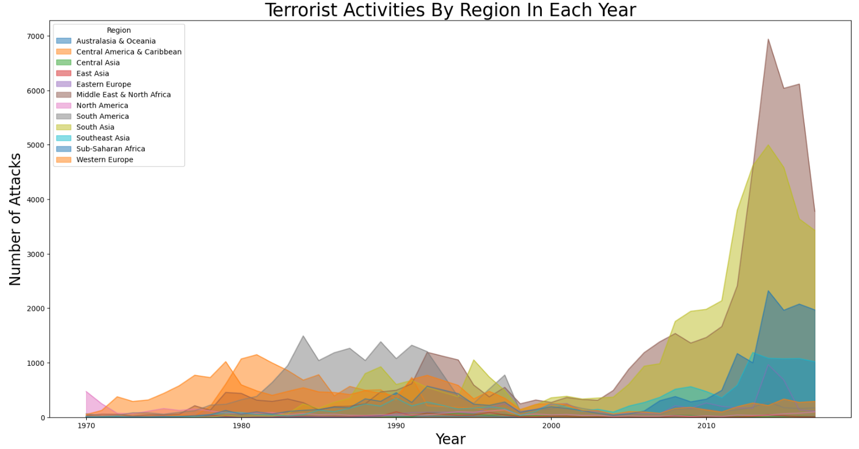
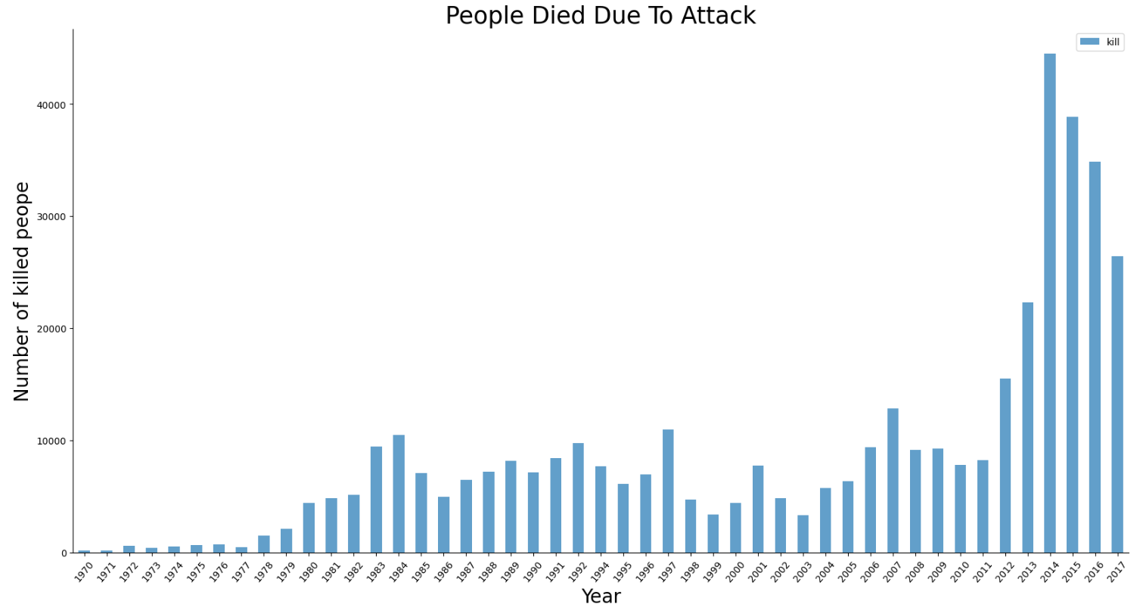
Data Visualization
The below bar chart shows the number of fatalities caused by terrorism each year.
The above area plot provides a deeper understanding of how terrorism has evolved in different regions over the years.

Slide 17
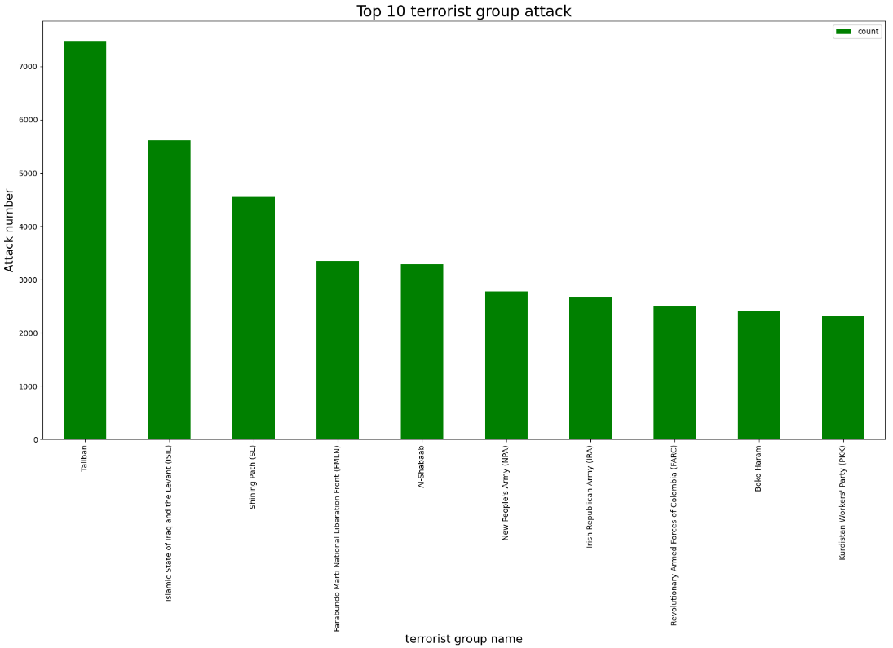
Data Visualization
The below bar chart shows the most active terrorist groups and the number of attacks they have carried out.
The above bar chart shows the number of fatalities caused by terrorism each year.

Slide 18
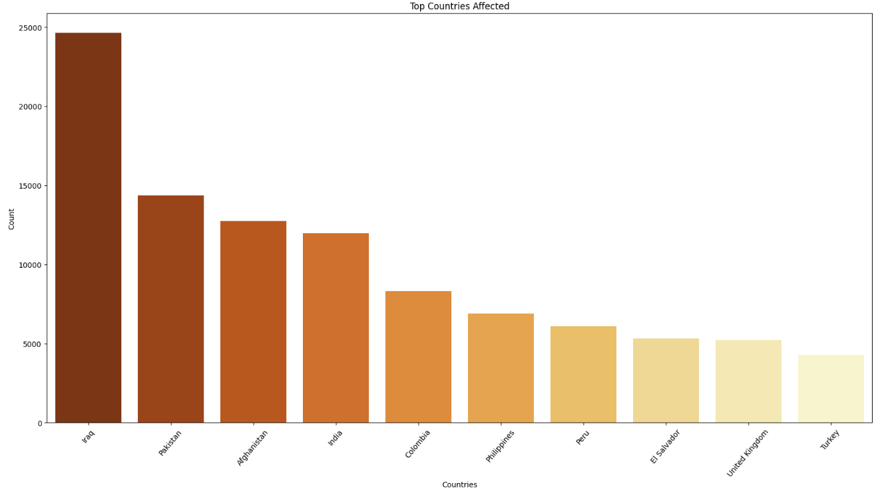
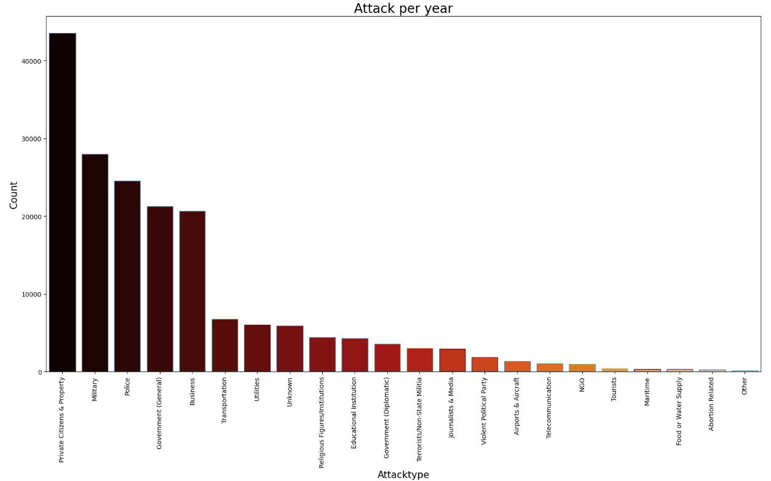
Data Visualization
The below graph shows the type of attack per year v/s the no. of attacks.
The above graph is between the countries and no. of attacks.

Slide 19
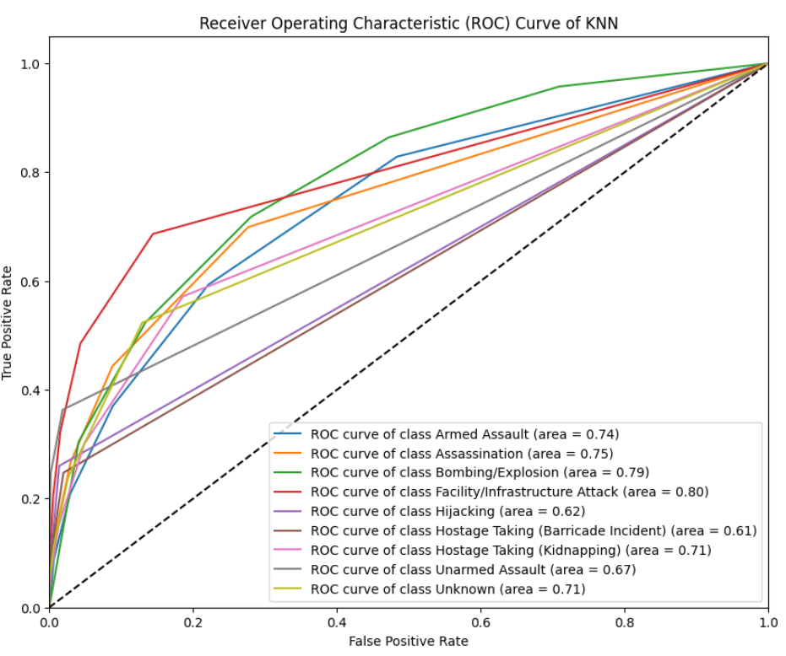
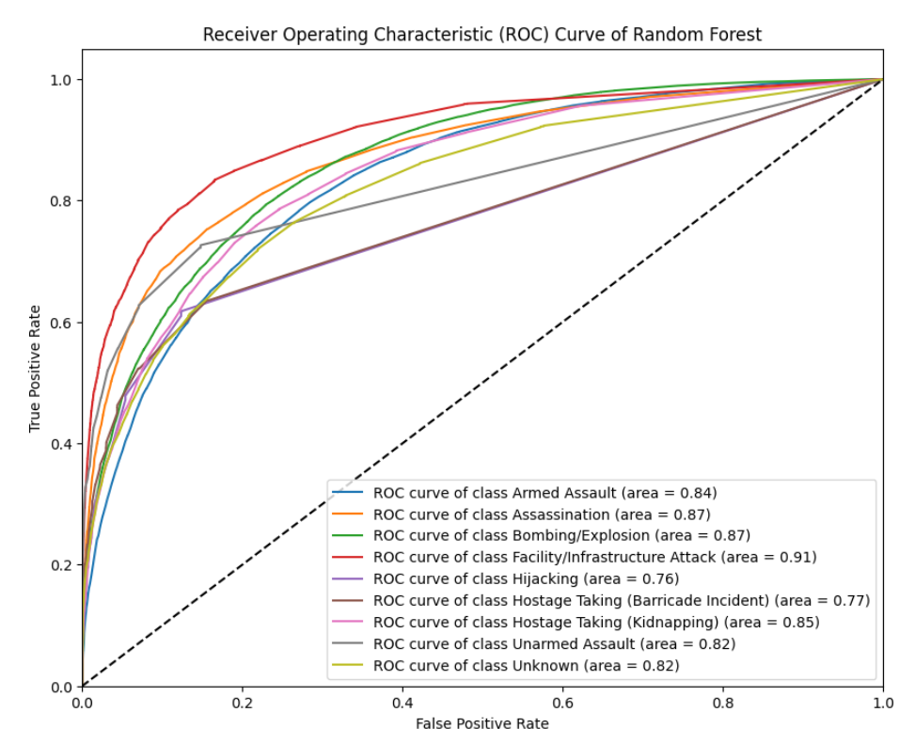
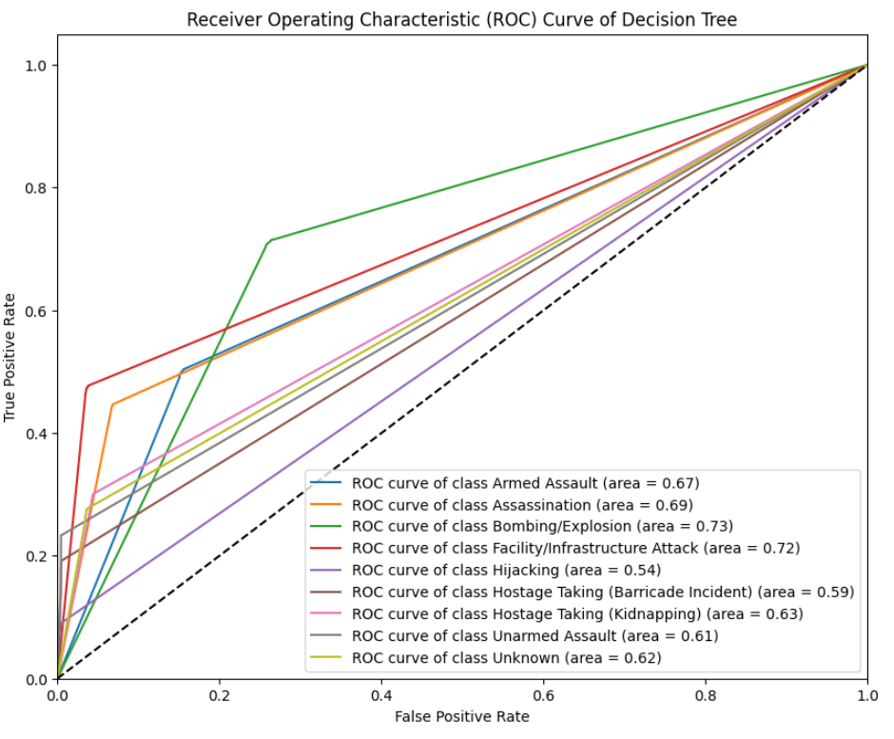
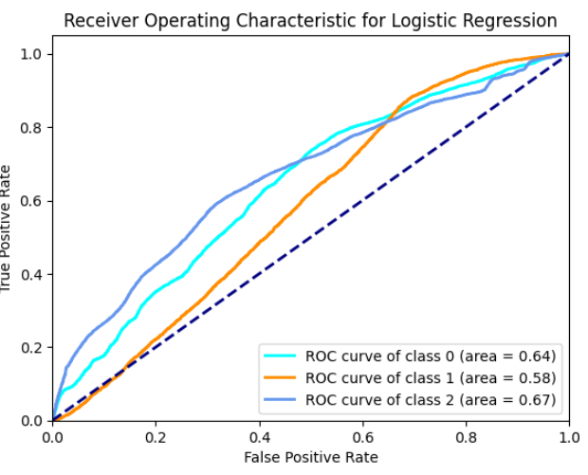
Data Visualization

Slide 20
Conclusion
Summary of Findings
The analysis uncovered:
Significant variations in terrorist activity over time, with certain years exhibiting peak activity.
A clear geographical distribution of terrorist attacks, with specific regions and countries experiencing a higher frequency and severity of attacks.
Predominant attack types and targets, highlighting the most common methods and objectives of terrorist groups.
Impact of Proposed Solution
This EDA provides valuable insights for policymakers, security agencies and researchers to:
Develop effective counter-terrorism strategies by understanding the evolving nature of terrorism.
Allocate resources effectively to regions and countries most vulnerable to terrorist attacks.
Prioritize efforts to address the root causes of terrorism, such as political instability, poverty, and extremism.
Future Work
Further Analysis:
Analyzing the relationship between attack types and weapons used.
Investigating the impact of different factors like political instability, poverty, and religious extremism on terrorism.
Developing predictive models to forecast future trends in terrorism.

Slide 21
References
Data Sources
Kaggle: https://www.kaggle.com/datasets/START-UMD/gtd
Tools and Software Used
The following tools and technologies will be used for data analysis:
1. Python: For data cleaning, analysis, and visualization, using libraries such as Pandas, NumPy, Matplotlib, and Seaborn.
2. Jupyter Notebooks: For documenting the analysis process and visualizations.

Slide 22
Thank You

